Slide 1
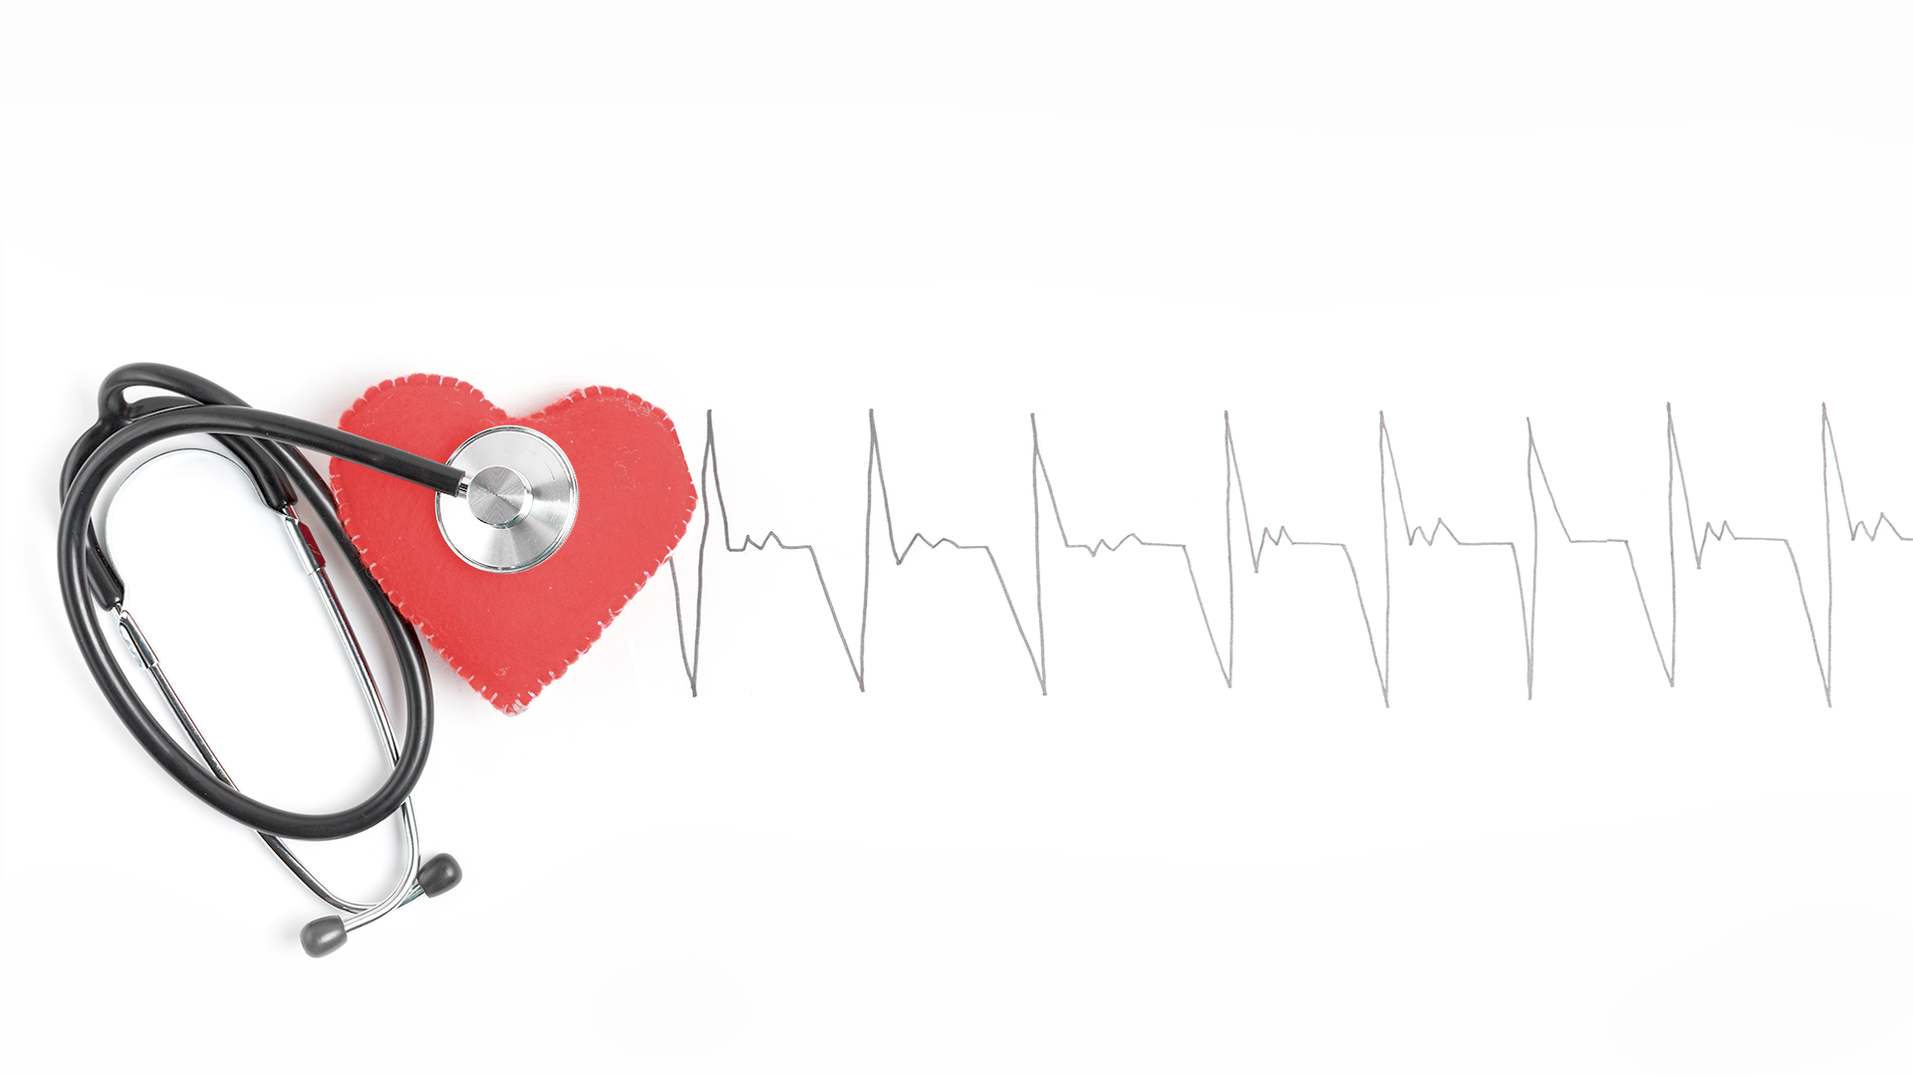
Exploring Gender
Differences in Heart Disease
“Skipping a Beat” Association
Leticia Salazar, Eilish Boyd, Alyssia Smith

Slide 2
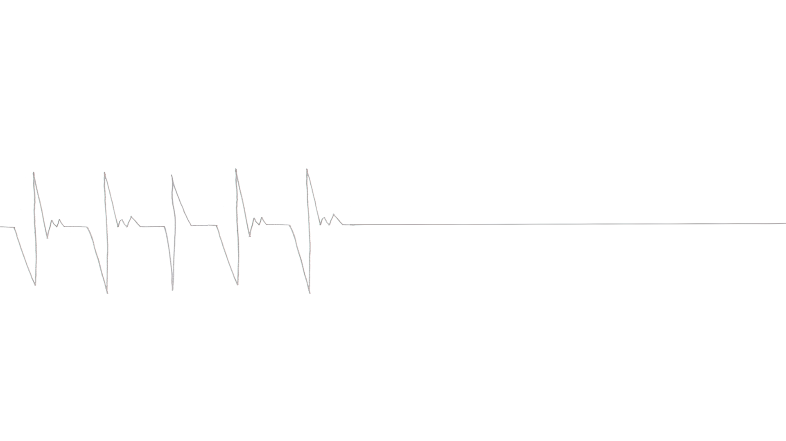
TABLE OF CONTENTS
03
05-07
10-11
04
08-09
Get to know your Heart
Our Findings
Thank you!
Q & A
Visit our Website and take a look at our findings.
F.Y.I
Fun Facts & Heart Attack Symptoms
“Be aware of your heart”

Slide 3
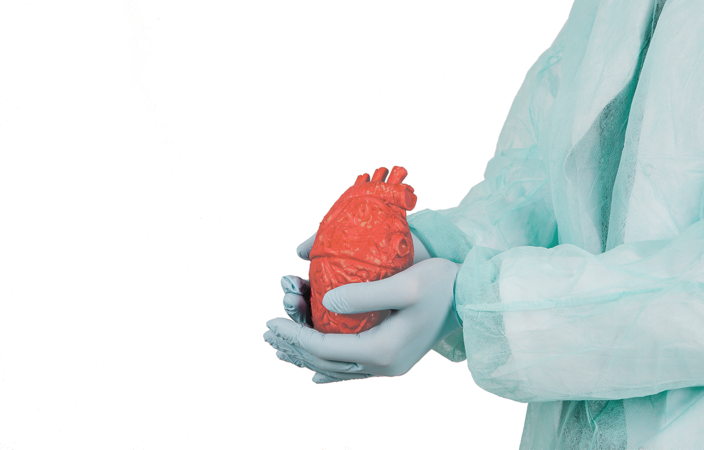
Get to know your Heart!
100,000
5,000
24
Our Heart beats
times a day
Gallons of blood flow through our body
hours a day non stop!
Taking care of your health can help YOU prevent heart disease.

Slide 4
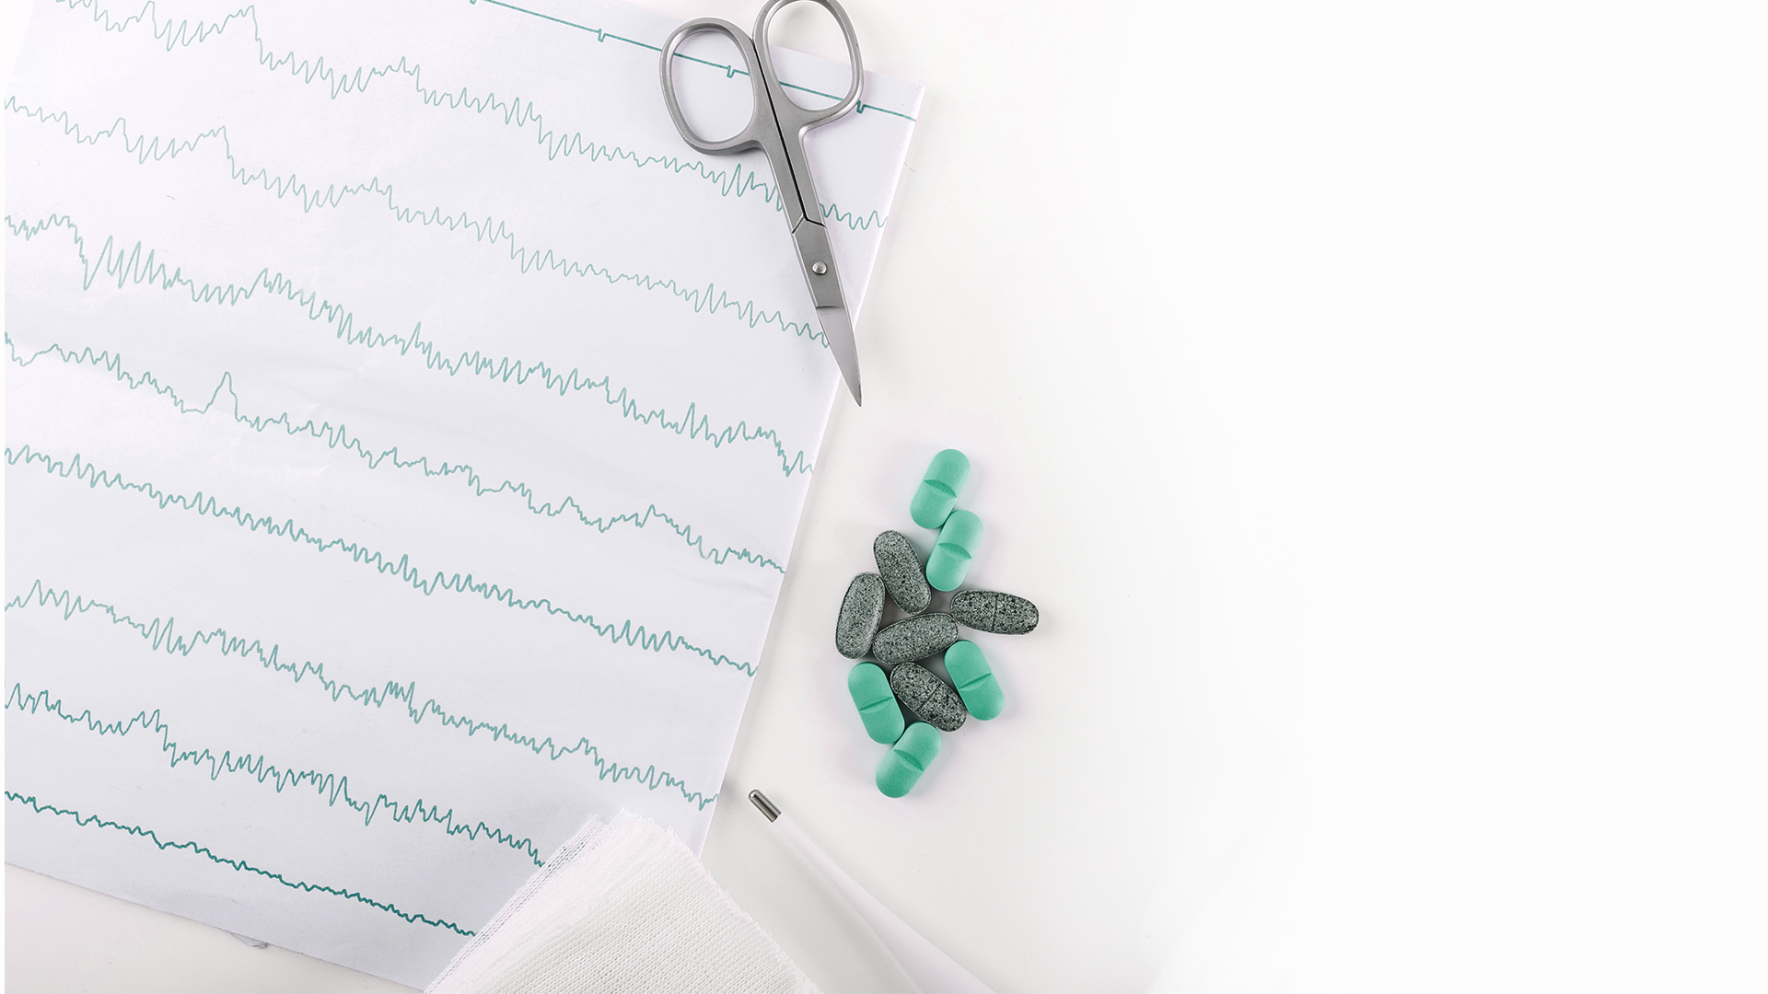
F.Y.I “Be Aware of your Heart”
Age and Gender
The older you get the more at risk you can be.
Important things to consider that cause heart disease:
Heredity
Heart diseases can be passed down!
Diet and Nutrition
Lack of a well balanced diet can also lead to heart disease

Slide 5
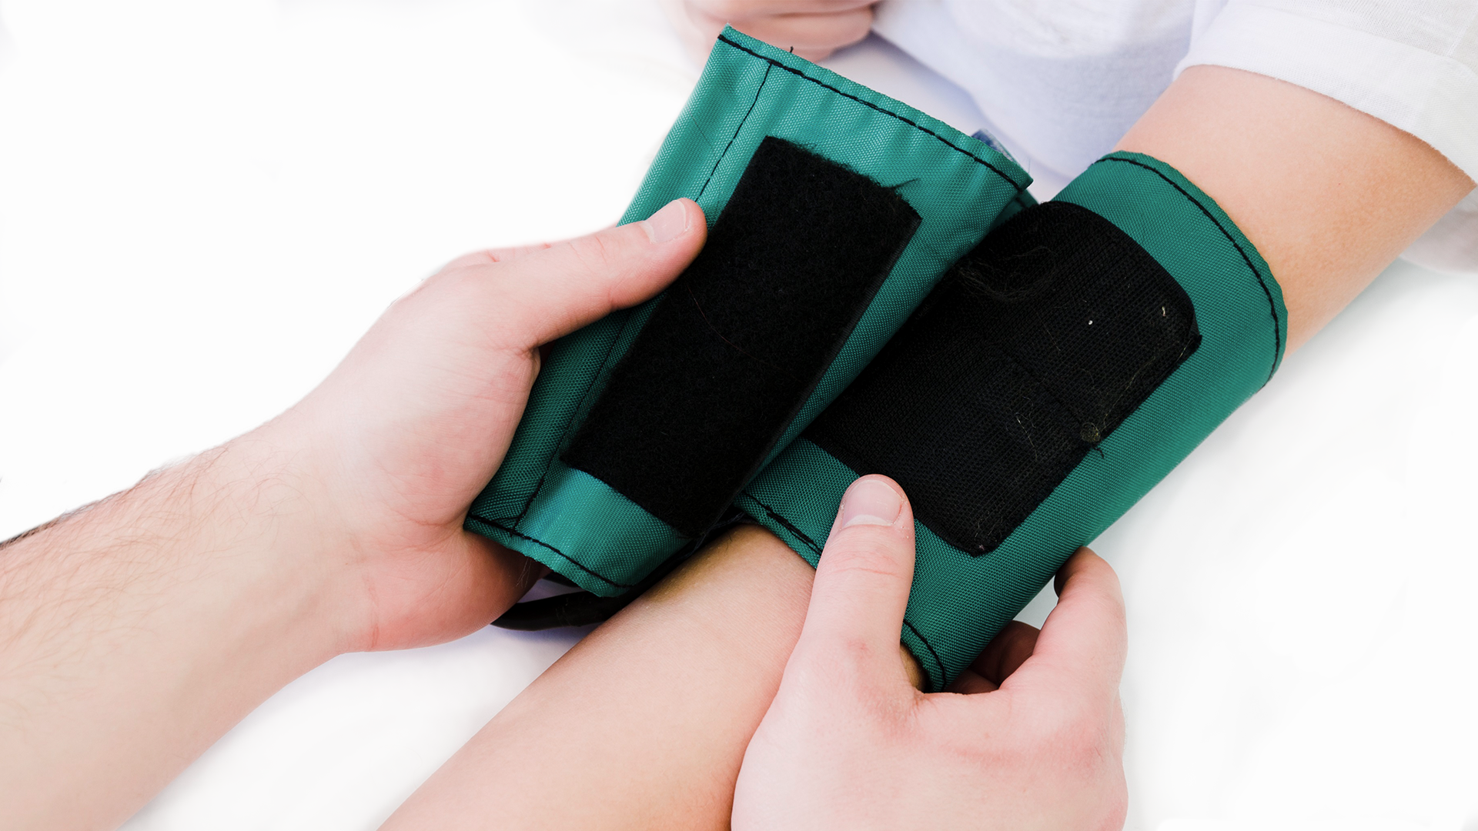
Our Findings
www.website.com

Slide 6

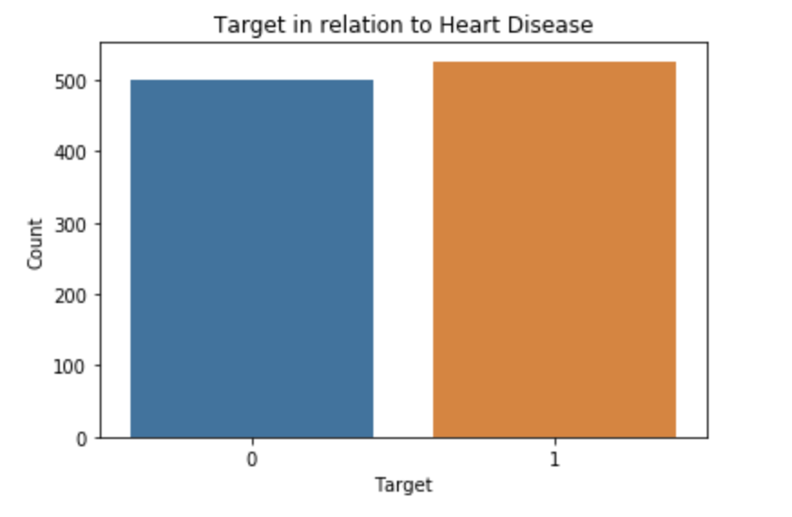
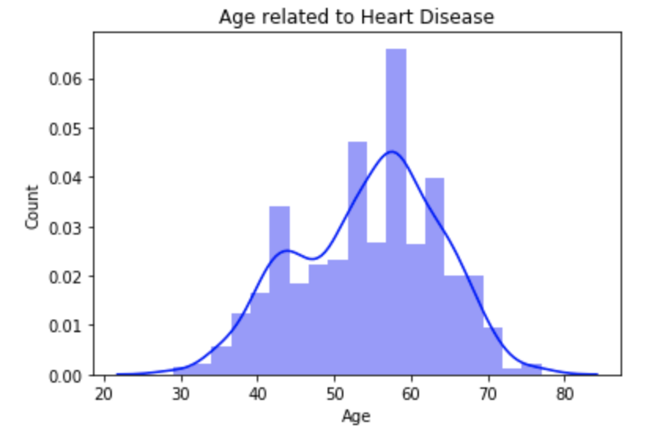

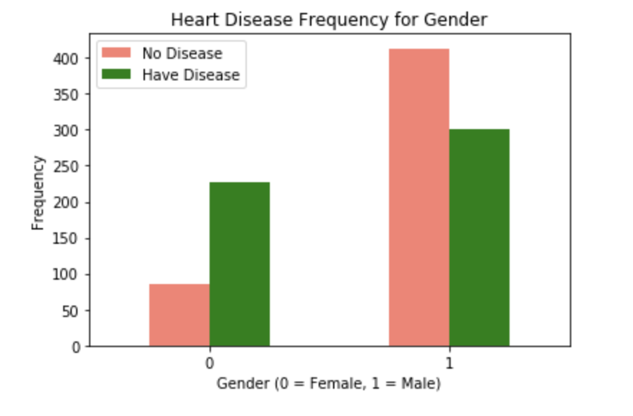
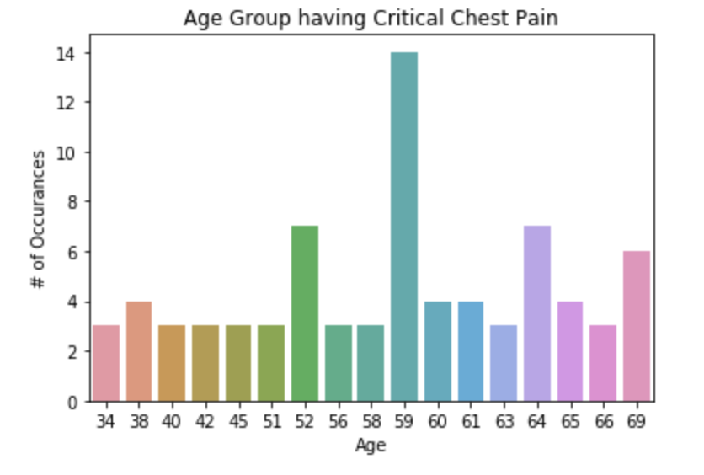
Insights
30.44%
51.32% have heart problems
48.68% do not
69.56%
Age Group ranges from 29 - 77 years old
Ages between 34 - 69 are more likely to have critical chest pain
Male are more likely to have a disease

Slide 7
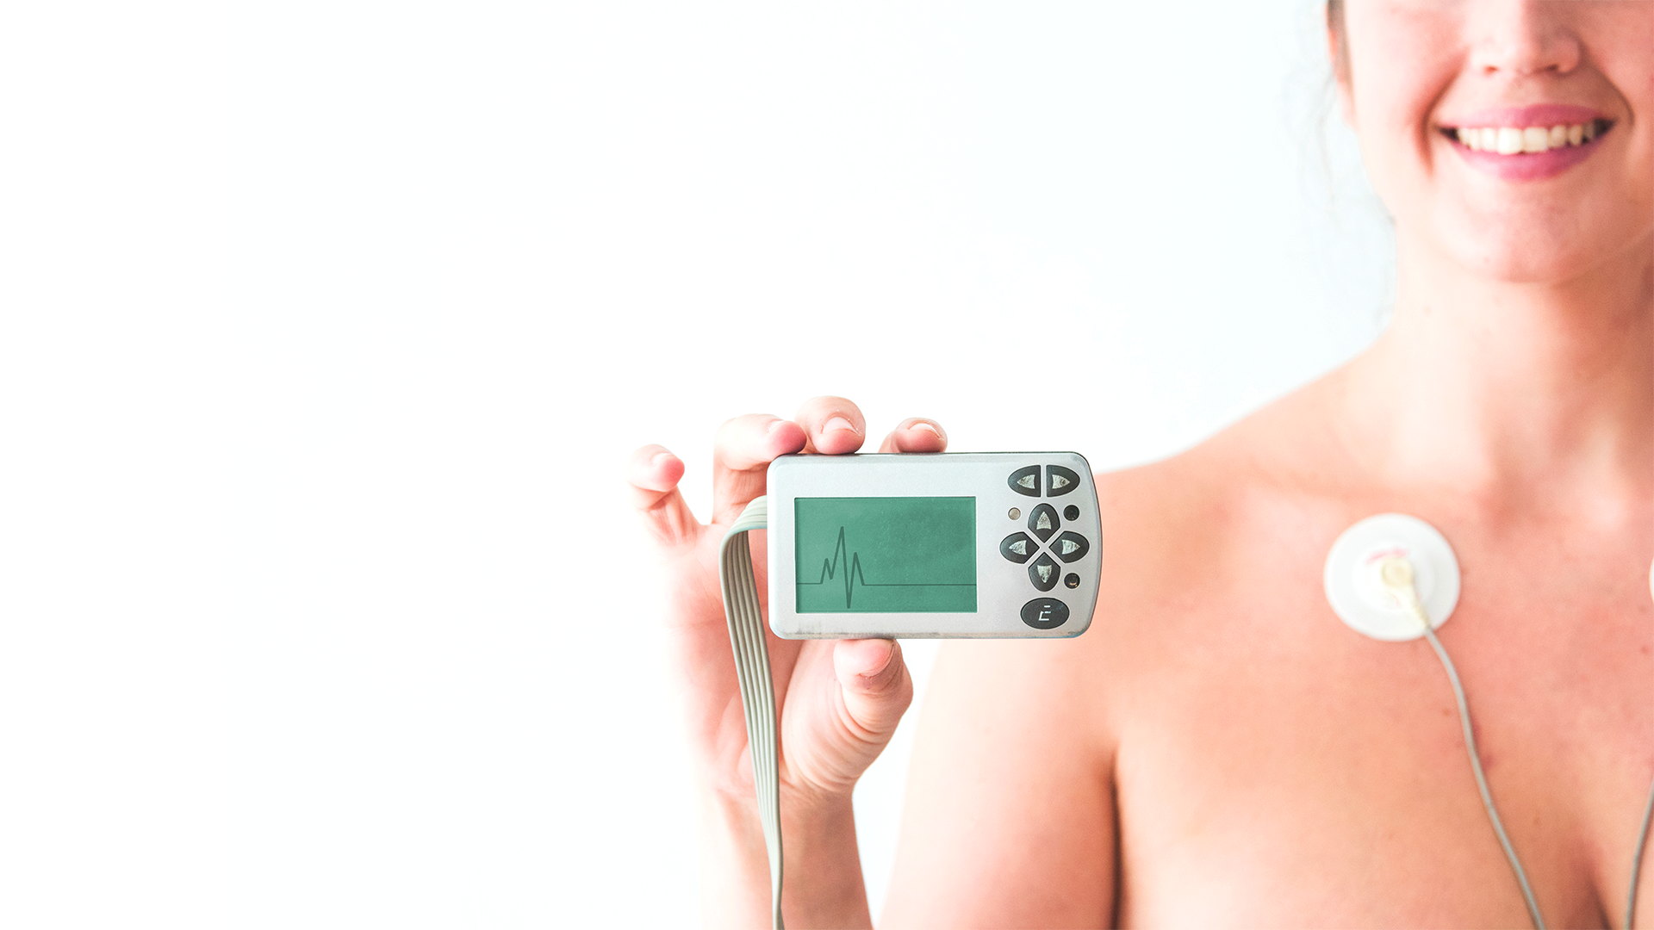
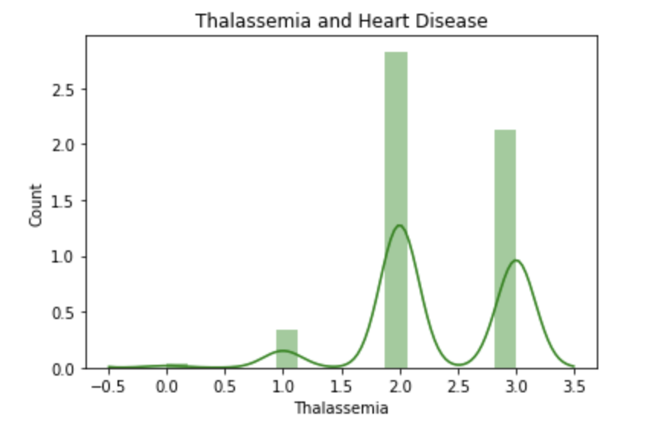
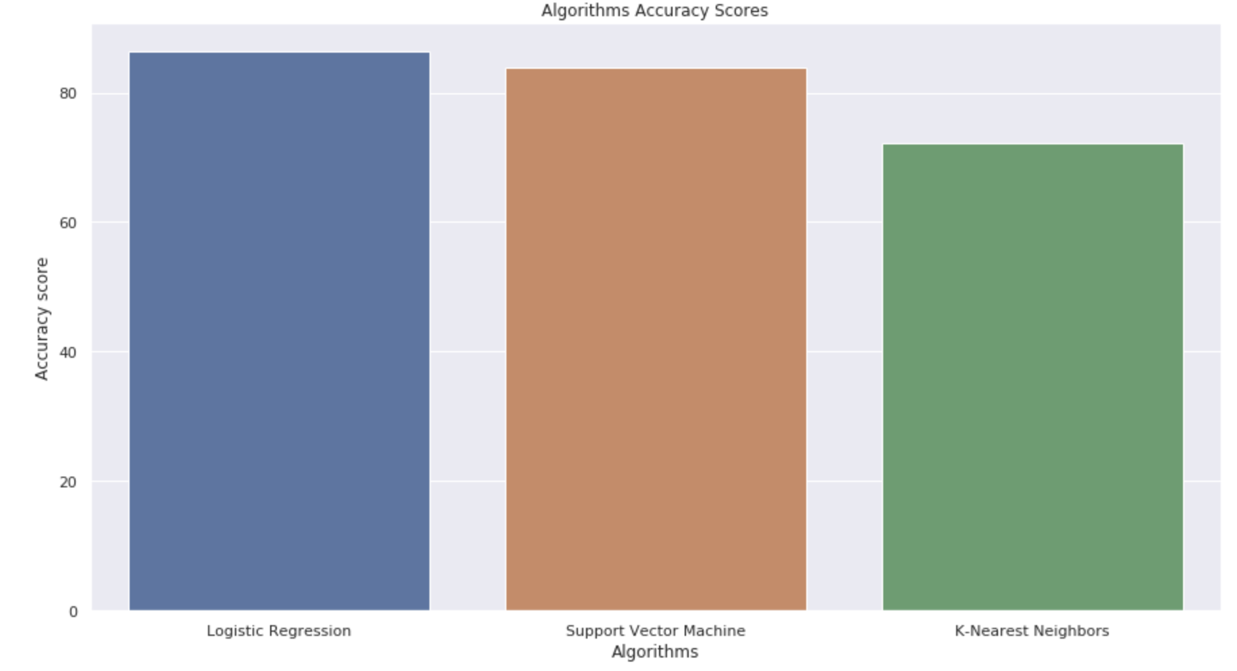
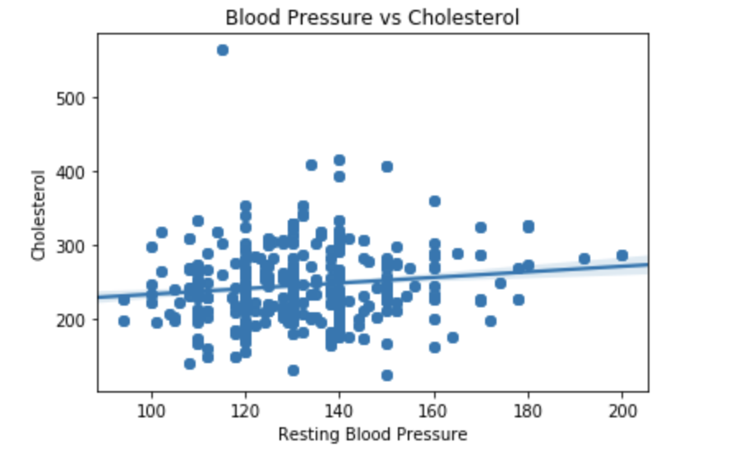
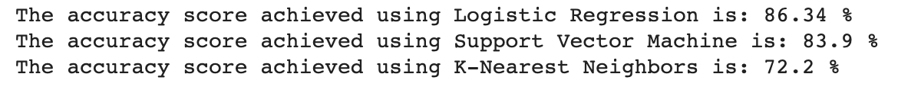
CONTINUATION...
There is a strong correlation between Blood Pressure and Cholesterol.
The higher the blood pressure and cholesterol, the more likely you are to suffer a heart disease.
This blood disorder has 3 levels.
If you fall under level 2 (Fixed Defect) or 3 (Reversible Defect) you are more likely to have heart disease based on your genetics.

Slide 8
Fun Facts
At younger ages, men face a greater risk of heart disease than women. On average, a first heart attack - the most common manifestation of this prevalent disease - strikes men at age 65. For women, the average age of a first heart attack is 72.
Since 1984, more women have died of heart disease than men each year, although that is partly because women generally live longer than men.
In women, heart disease risks appear to rise after menopause; experts believe that in younger women, naturally occuring hormones may play a protective role.
Reference: https://www.health.harvard.edu/heart-health/the-heart-attack-gender-gap

Slide 9

Heart Attack Symptoms
Classic Symptoms | Nonclassic Symptoms
Pressure, aching, or tightness in the center of the chest Pain or discomfort that radiates to the upper body, especially shoulders or neck and arms Sweating | Shortness of Breath Weakness Nausea or Vomiting Dizziness Back pain Unexplained fatigue

Slide 10


THANK YOU!

Slide 11
Q & A

